Slide 1
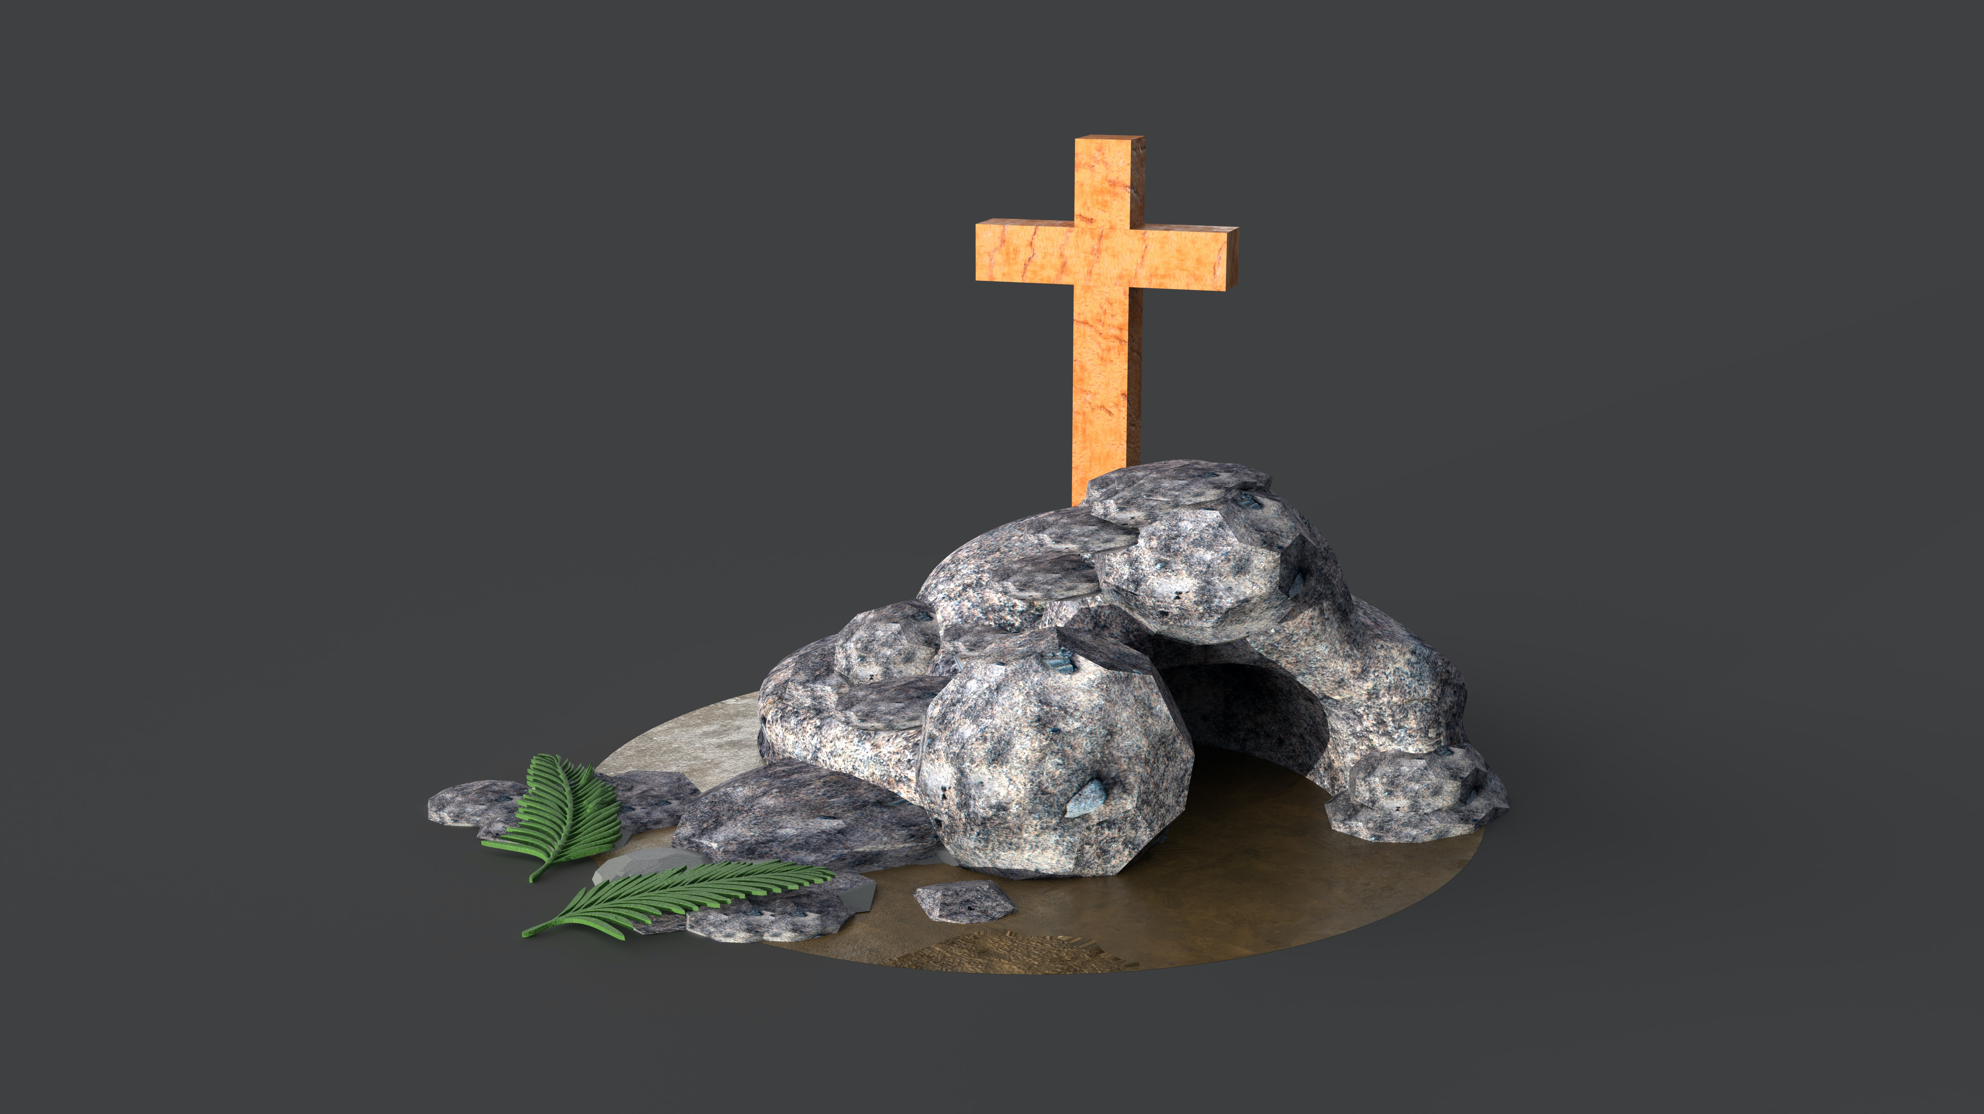
Ready to Show Christ to our Neighbors

Slide 2
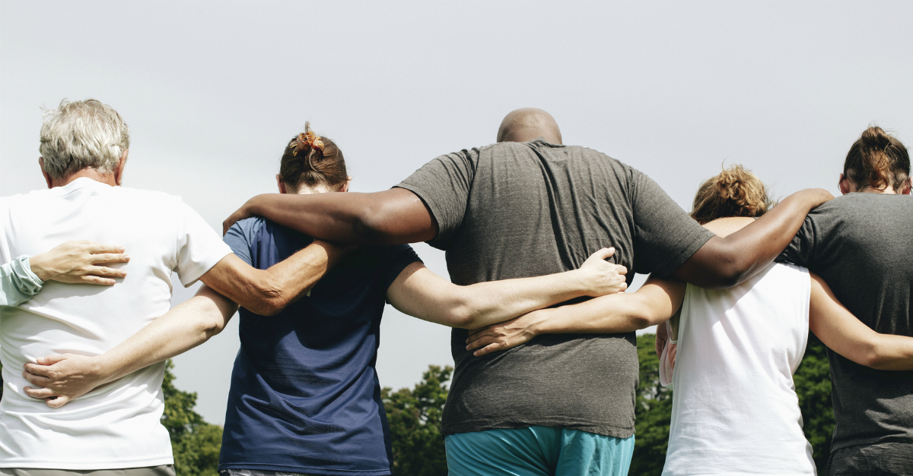
Reason #1: So the Gospel will extend beyond the walls of the building
Acts 2:41-47; 8:4-5; 10:20; 8:1
Acts 8:25
Luke 24:32
Acts 11:19
Acts 8:26
Luke 24:35, 47
Acts 9:11

Slide 3
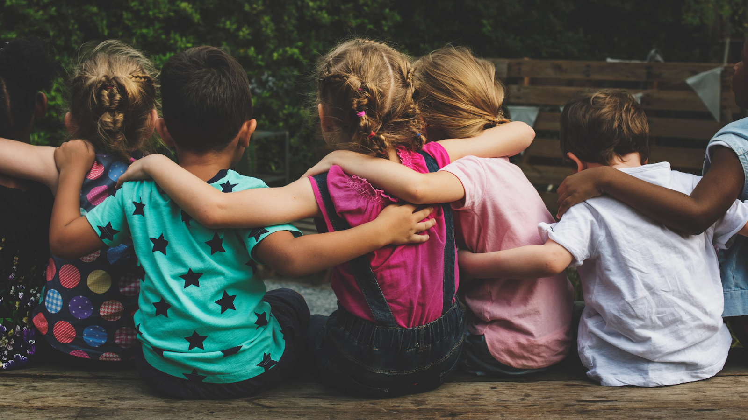
Reason #2: So our children will have a “safer” haven to grow up in
Rom. 12:2
1 Pet. 5:8
1 Cor.15:33
John 14:27
John 15:4-5

Slide 4
Heb. 13:8
Jer. 10:23
1 Pet. 1:25
2 Tim. 3:16-17
Judges 17:6
1 Cor. 11:1
Judges 21:25
Reason #3:
So people will know of a standard beyond their own

Slide 5
Reason #4:
Because the world needs to see the difference between the holy and the profane
1 Pet. 1:13-16
Psa. 24:1
John 3:16a
Col. 3:12-14

Slide 6
Reason #5:
Because we are the only Bible some people will ever read
Phi. 1:19-21
1 Tim. 4:12-13,15-16

Slide 7
Reason #6:
Because God’s Going to Hold Us Accountable
Ezk. 3:18-21
Acts 2:37-38
Mark 16:15-16
Rev. 21:21-27
James 1:21
Rom. 10:14

Slide 8
Ready to Show Christ to our Neighbors

